Slide 1
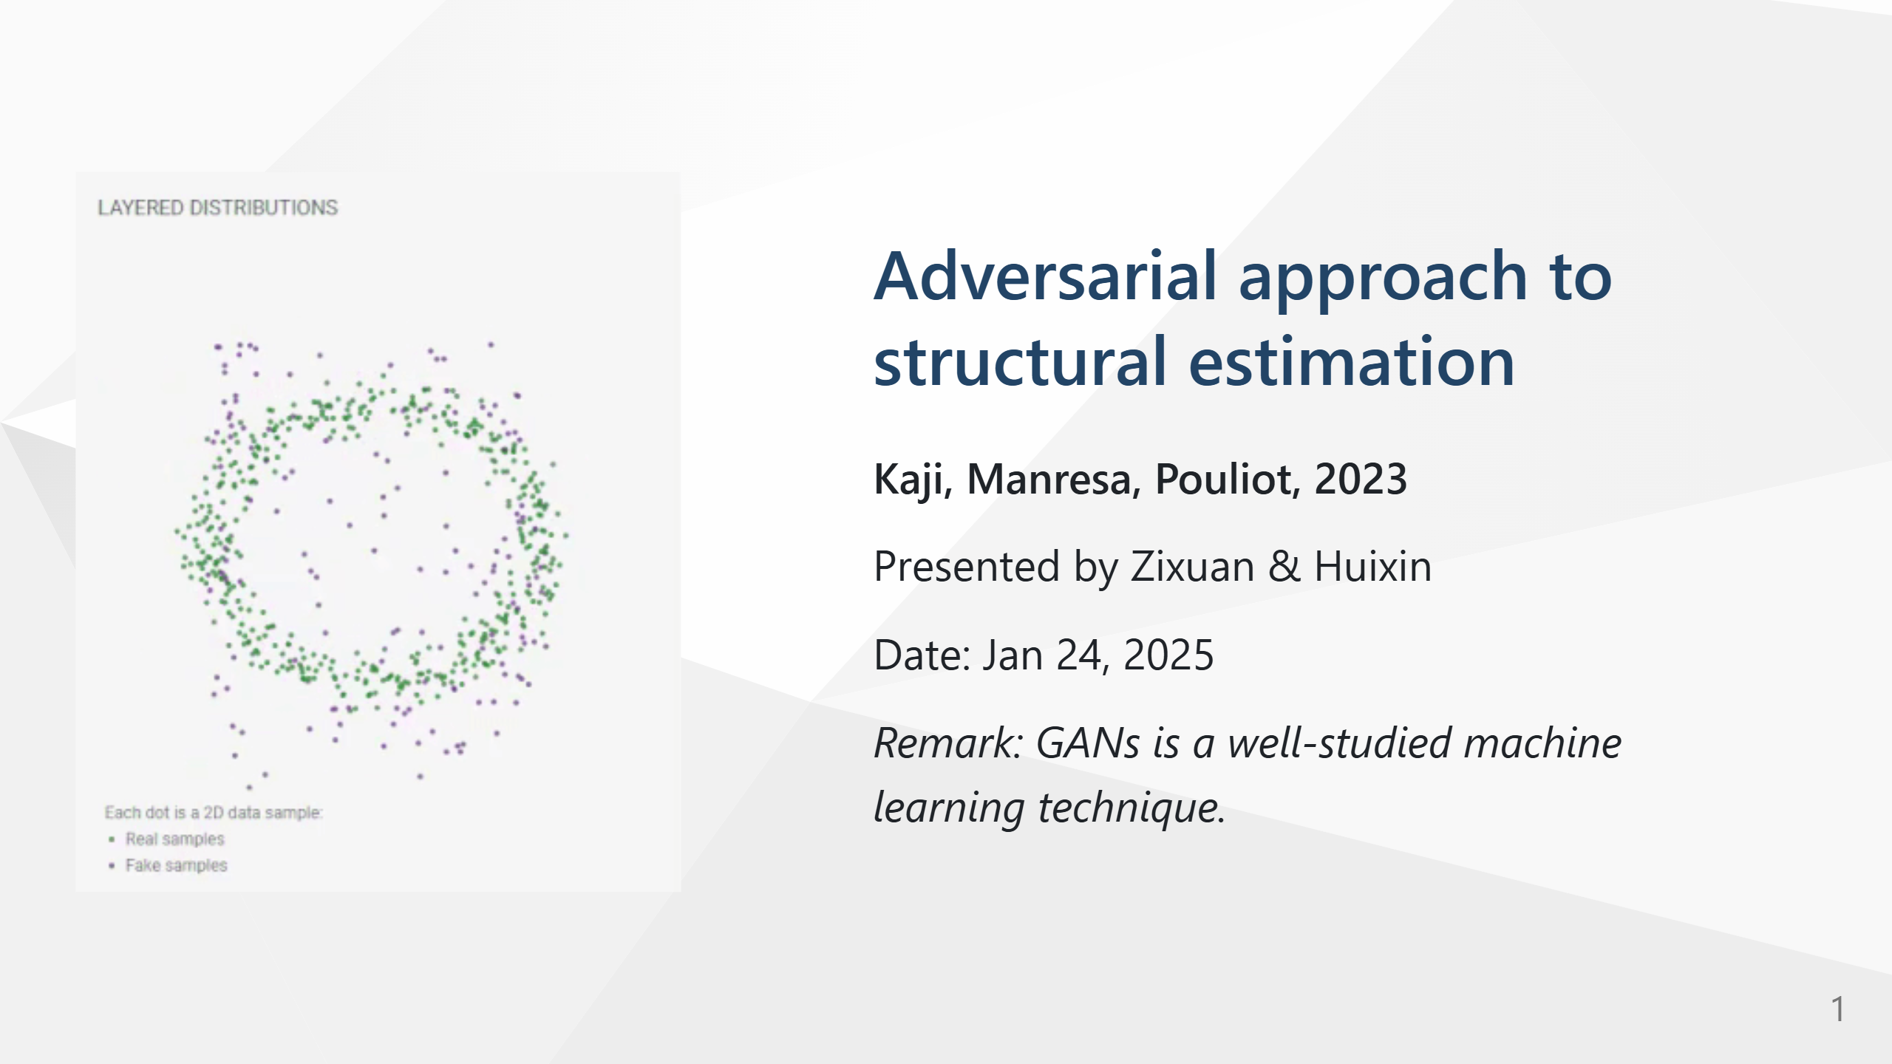

Slide 2
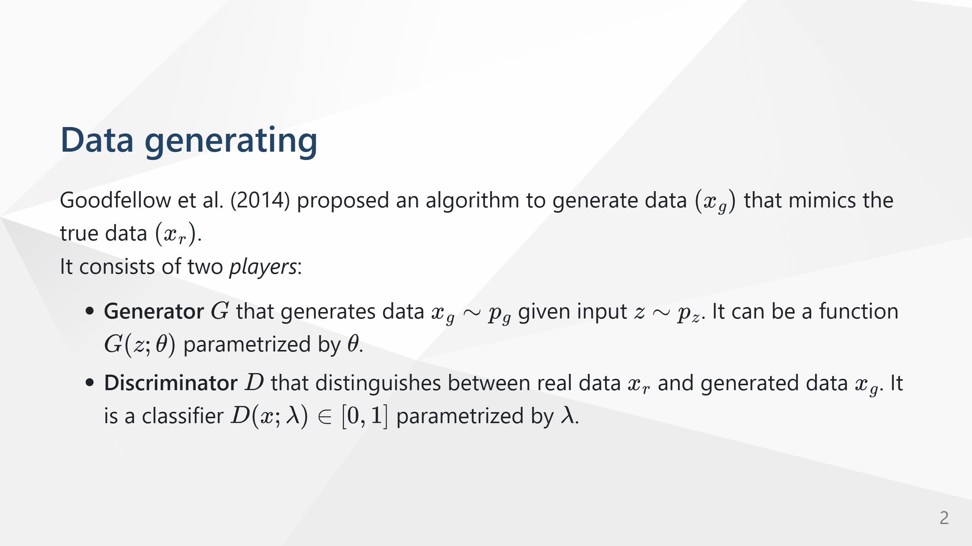

Slide 3
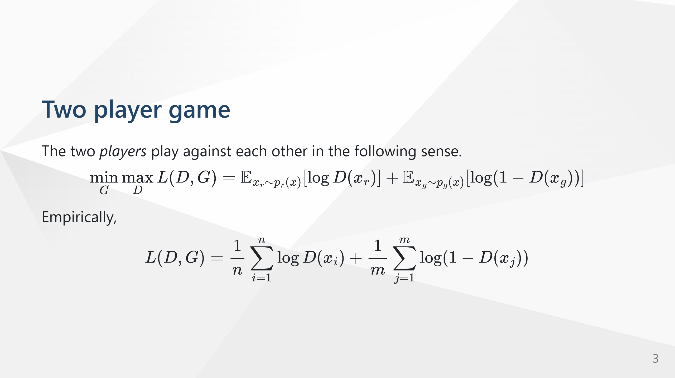

Slide 4
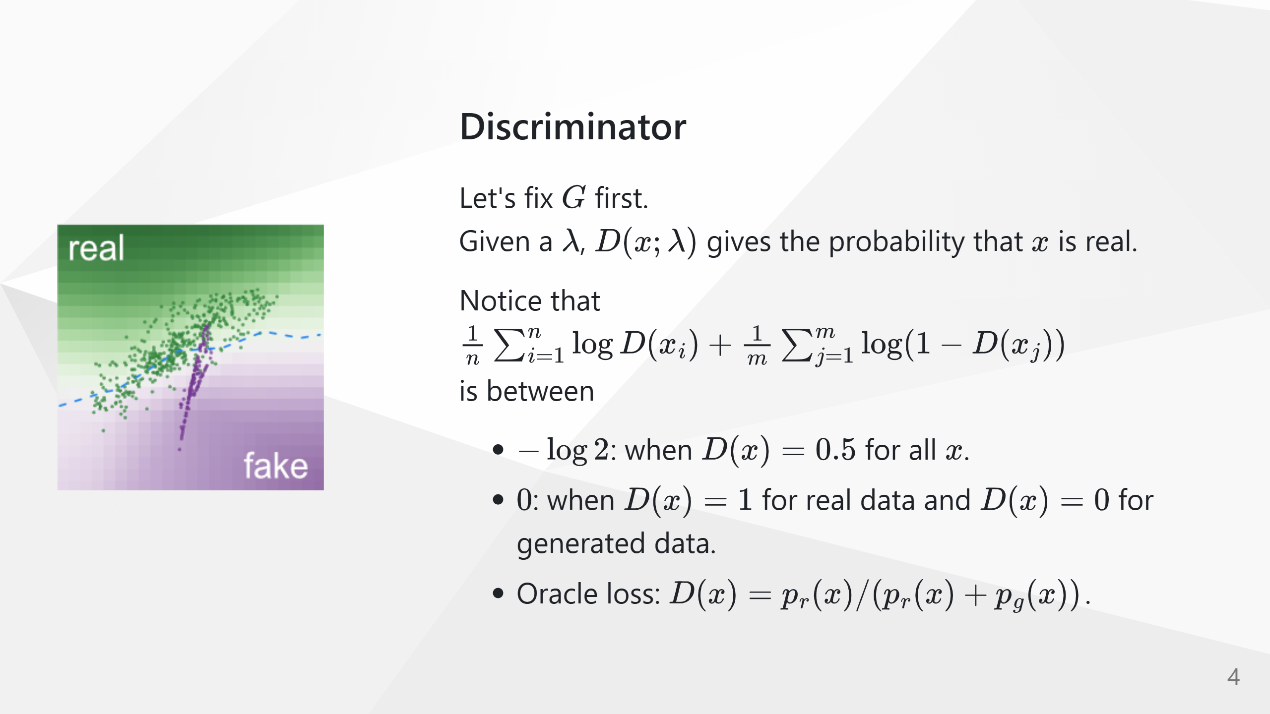

Slide 5
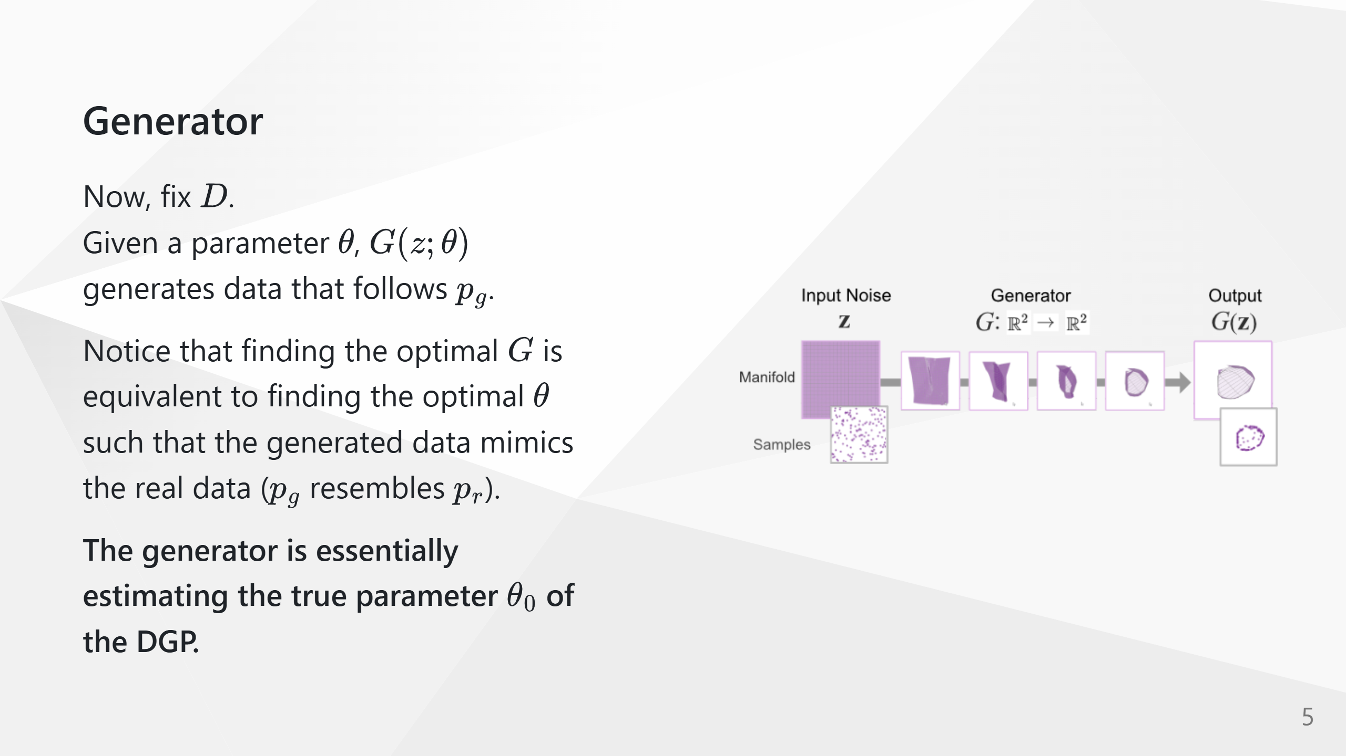

Slide 6
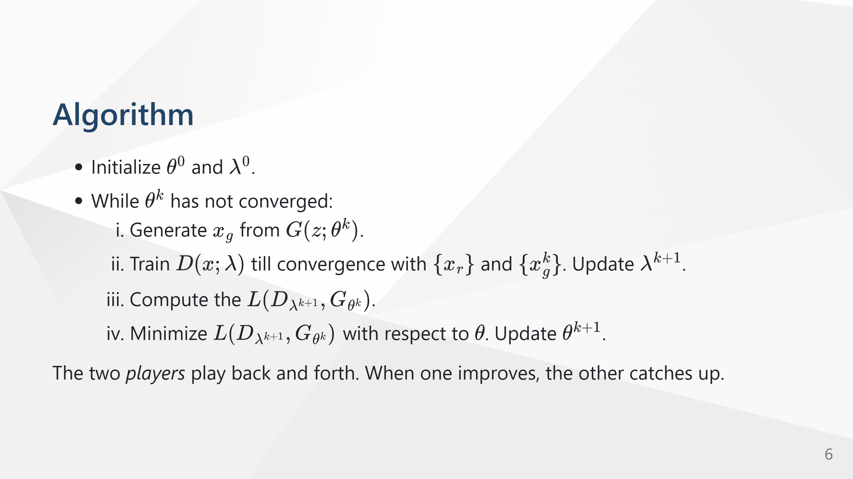

Slide 7
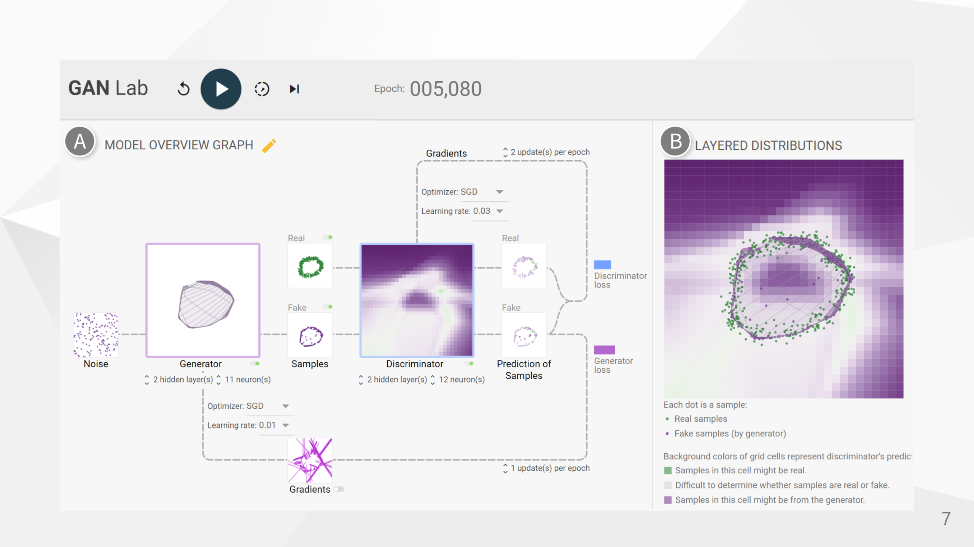

Slide 8
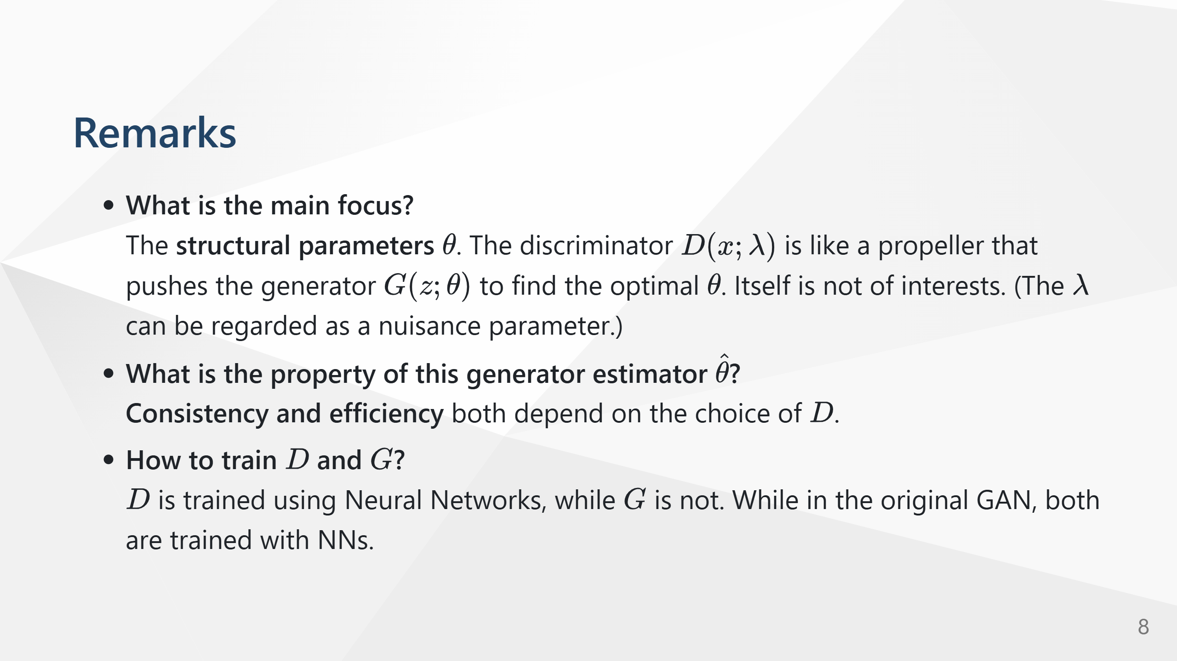

Slide 9
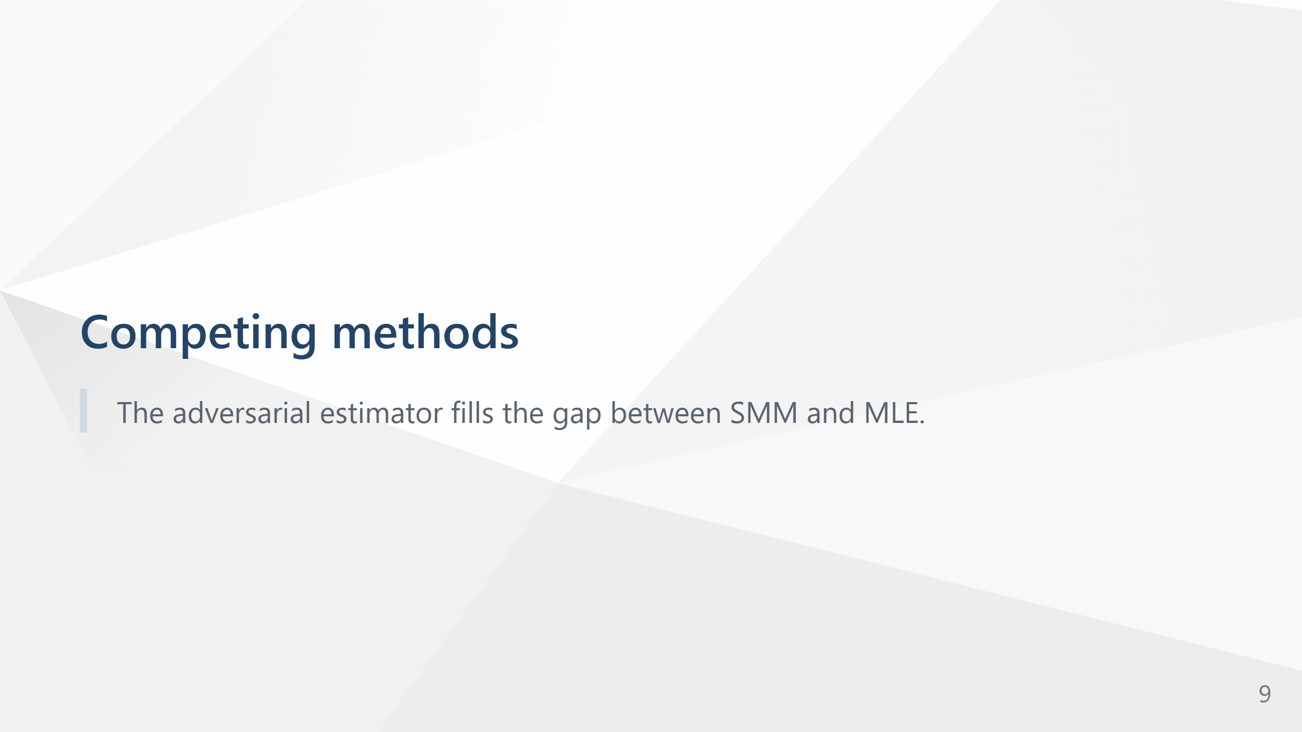

Slide 10
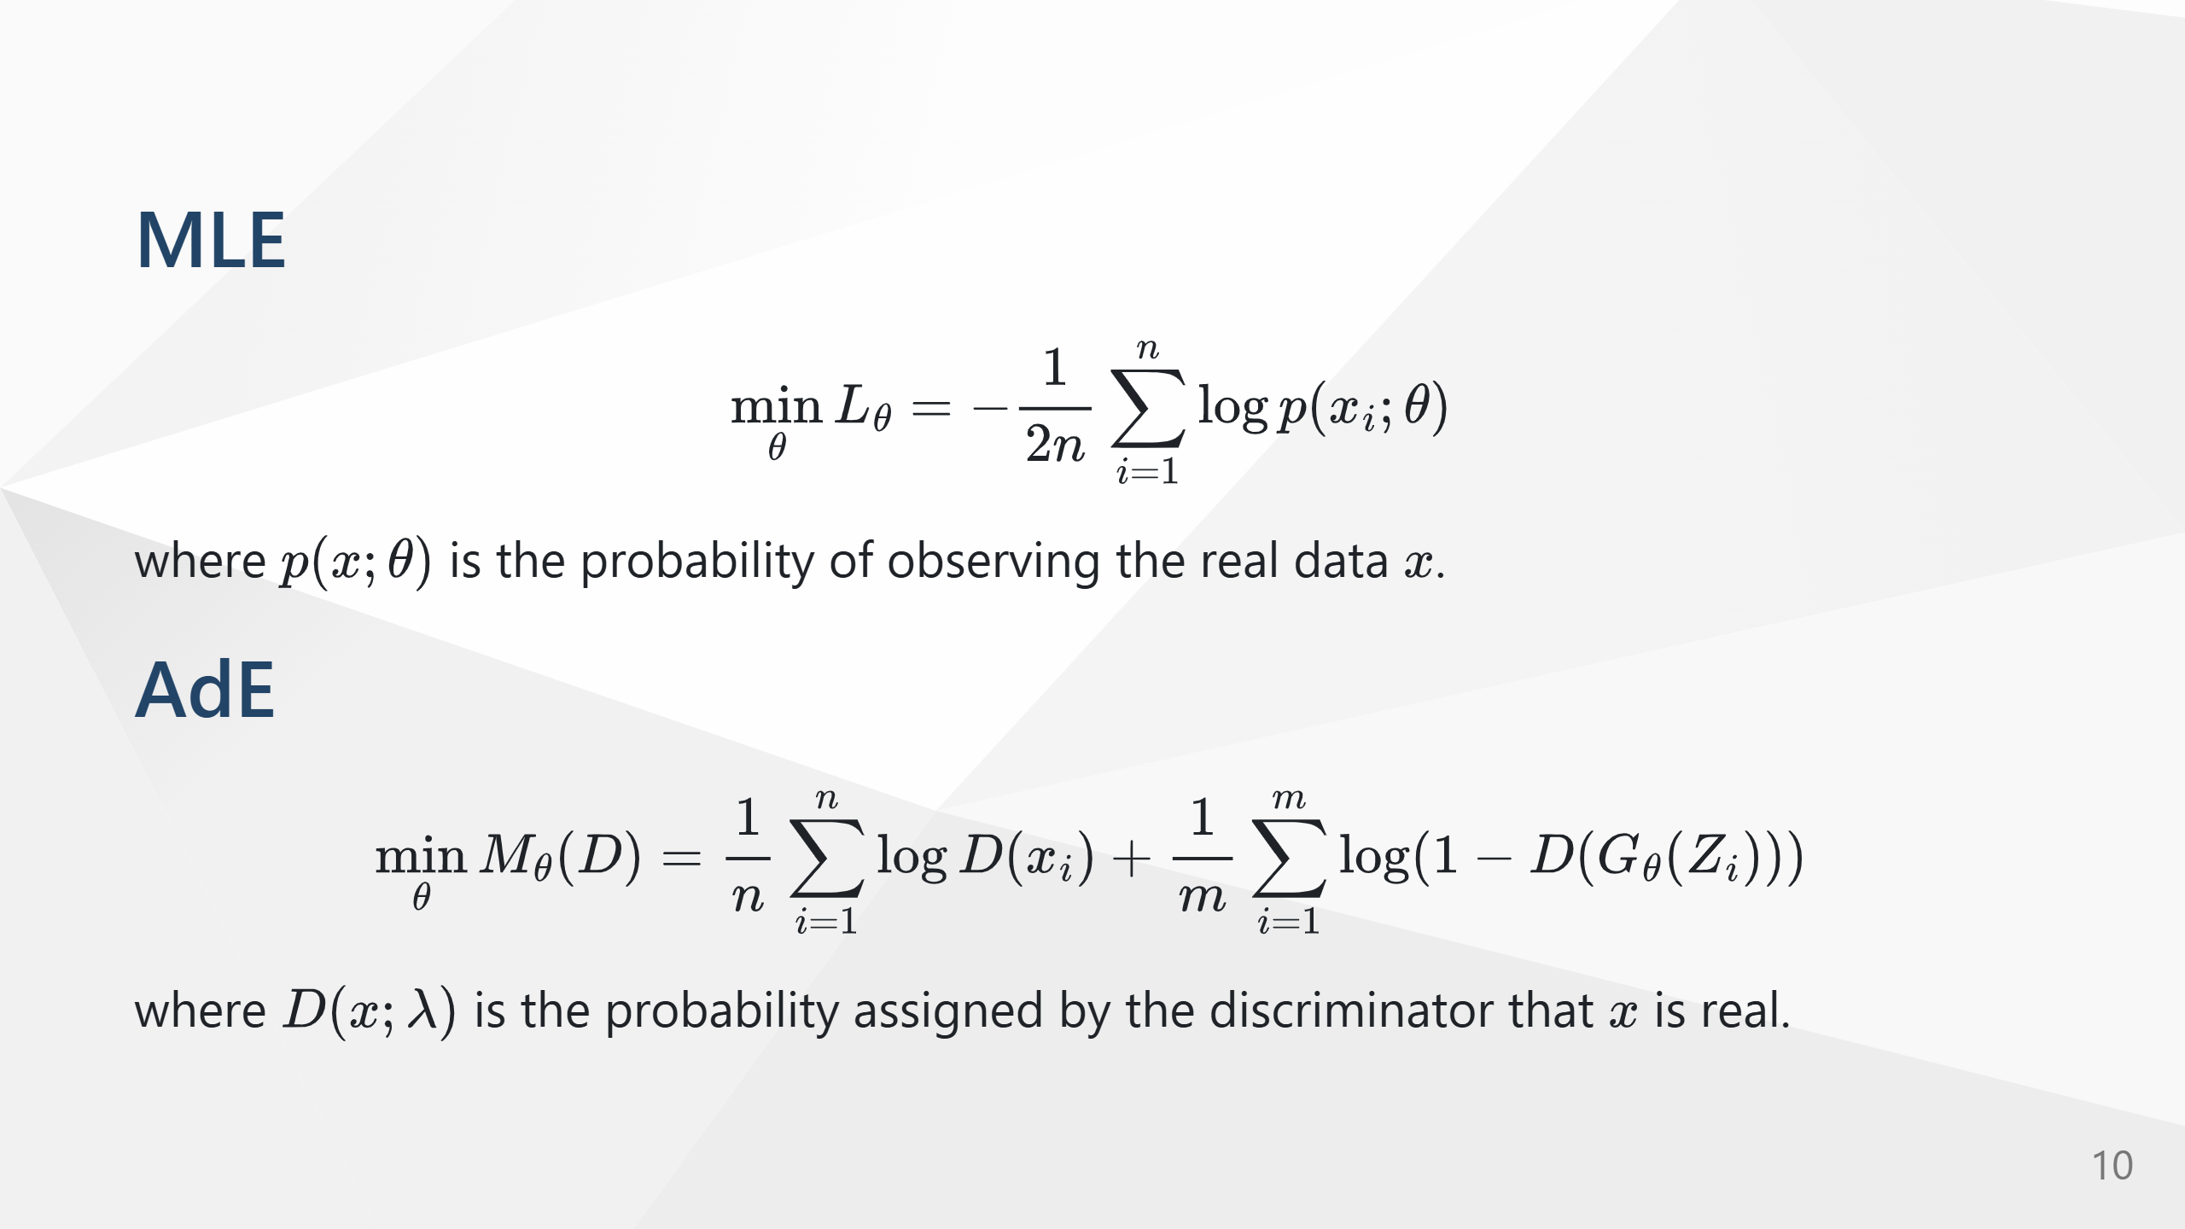

Slide 11
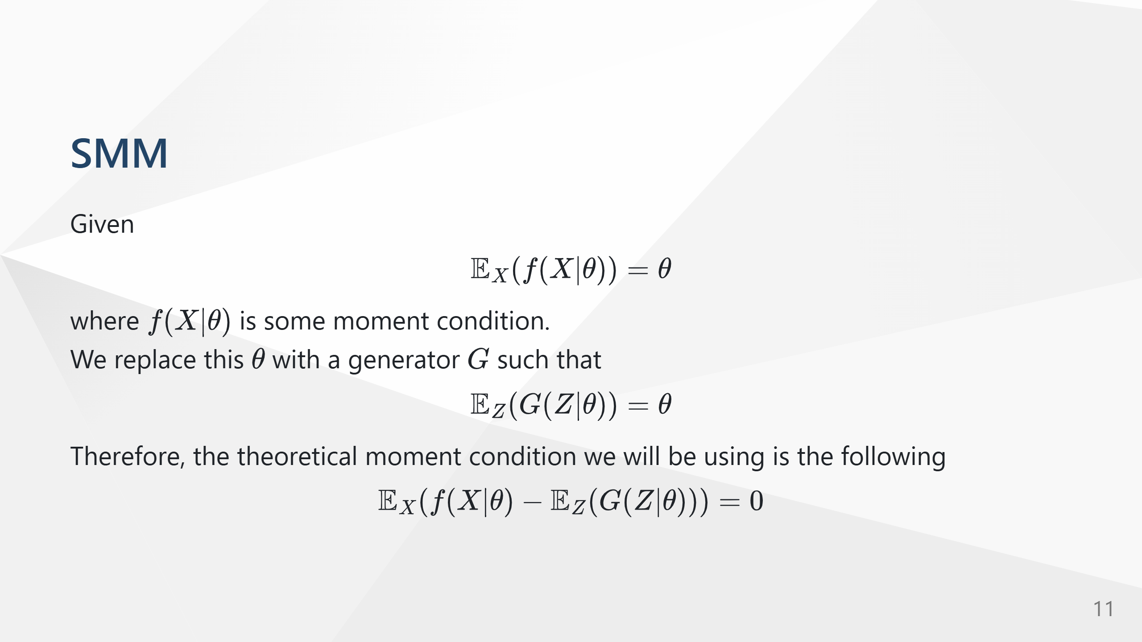

Slide 12
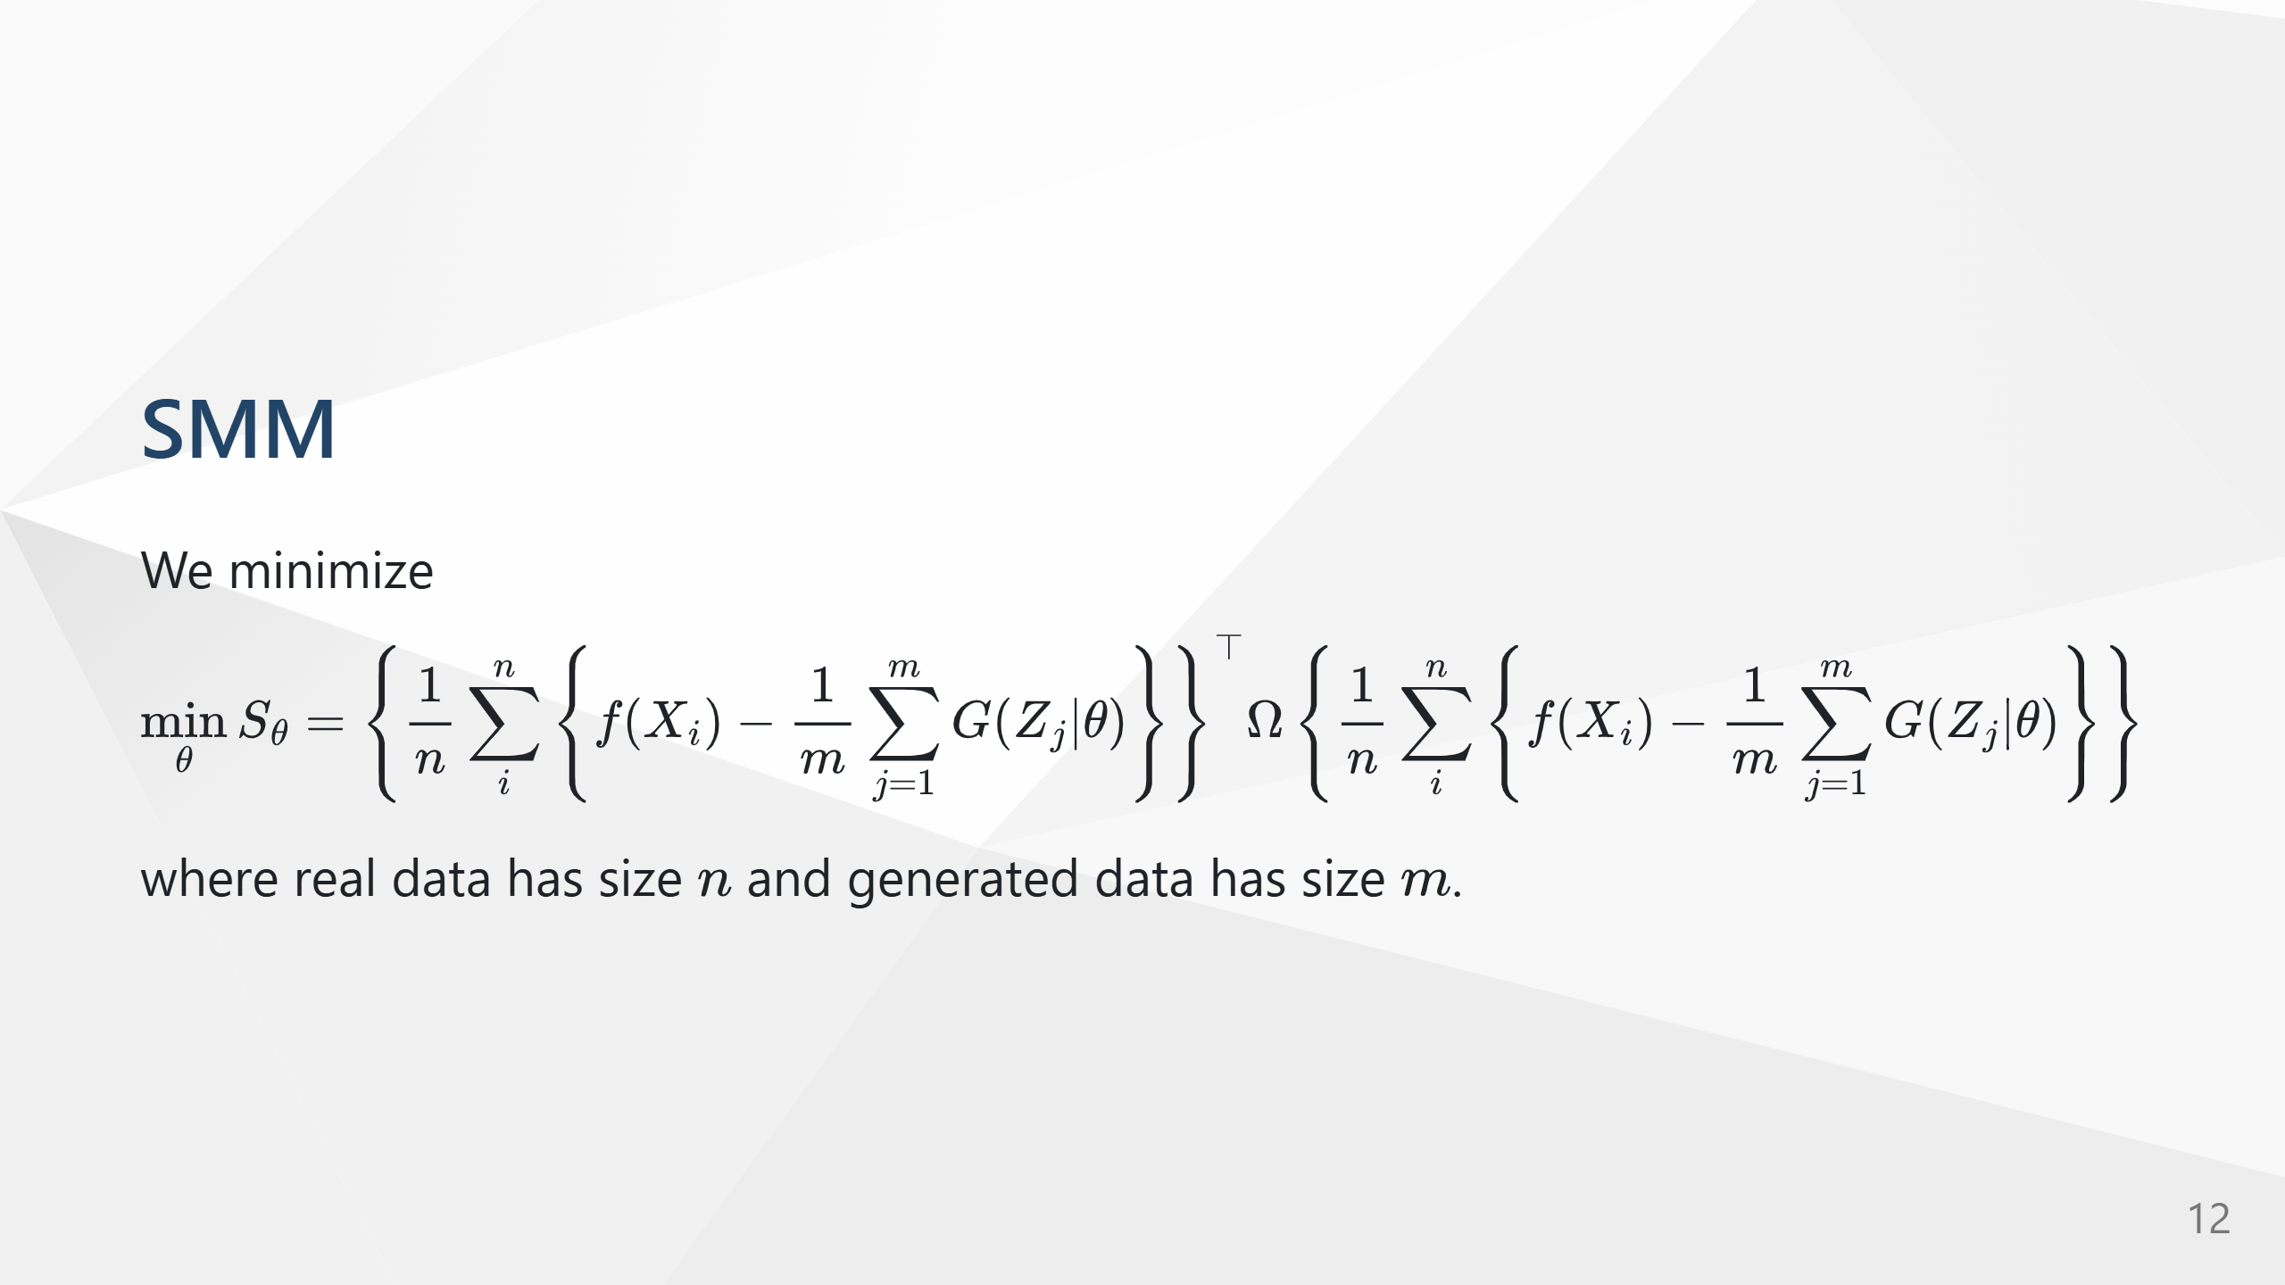

Slide 13
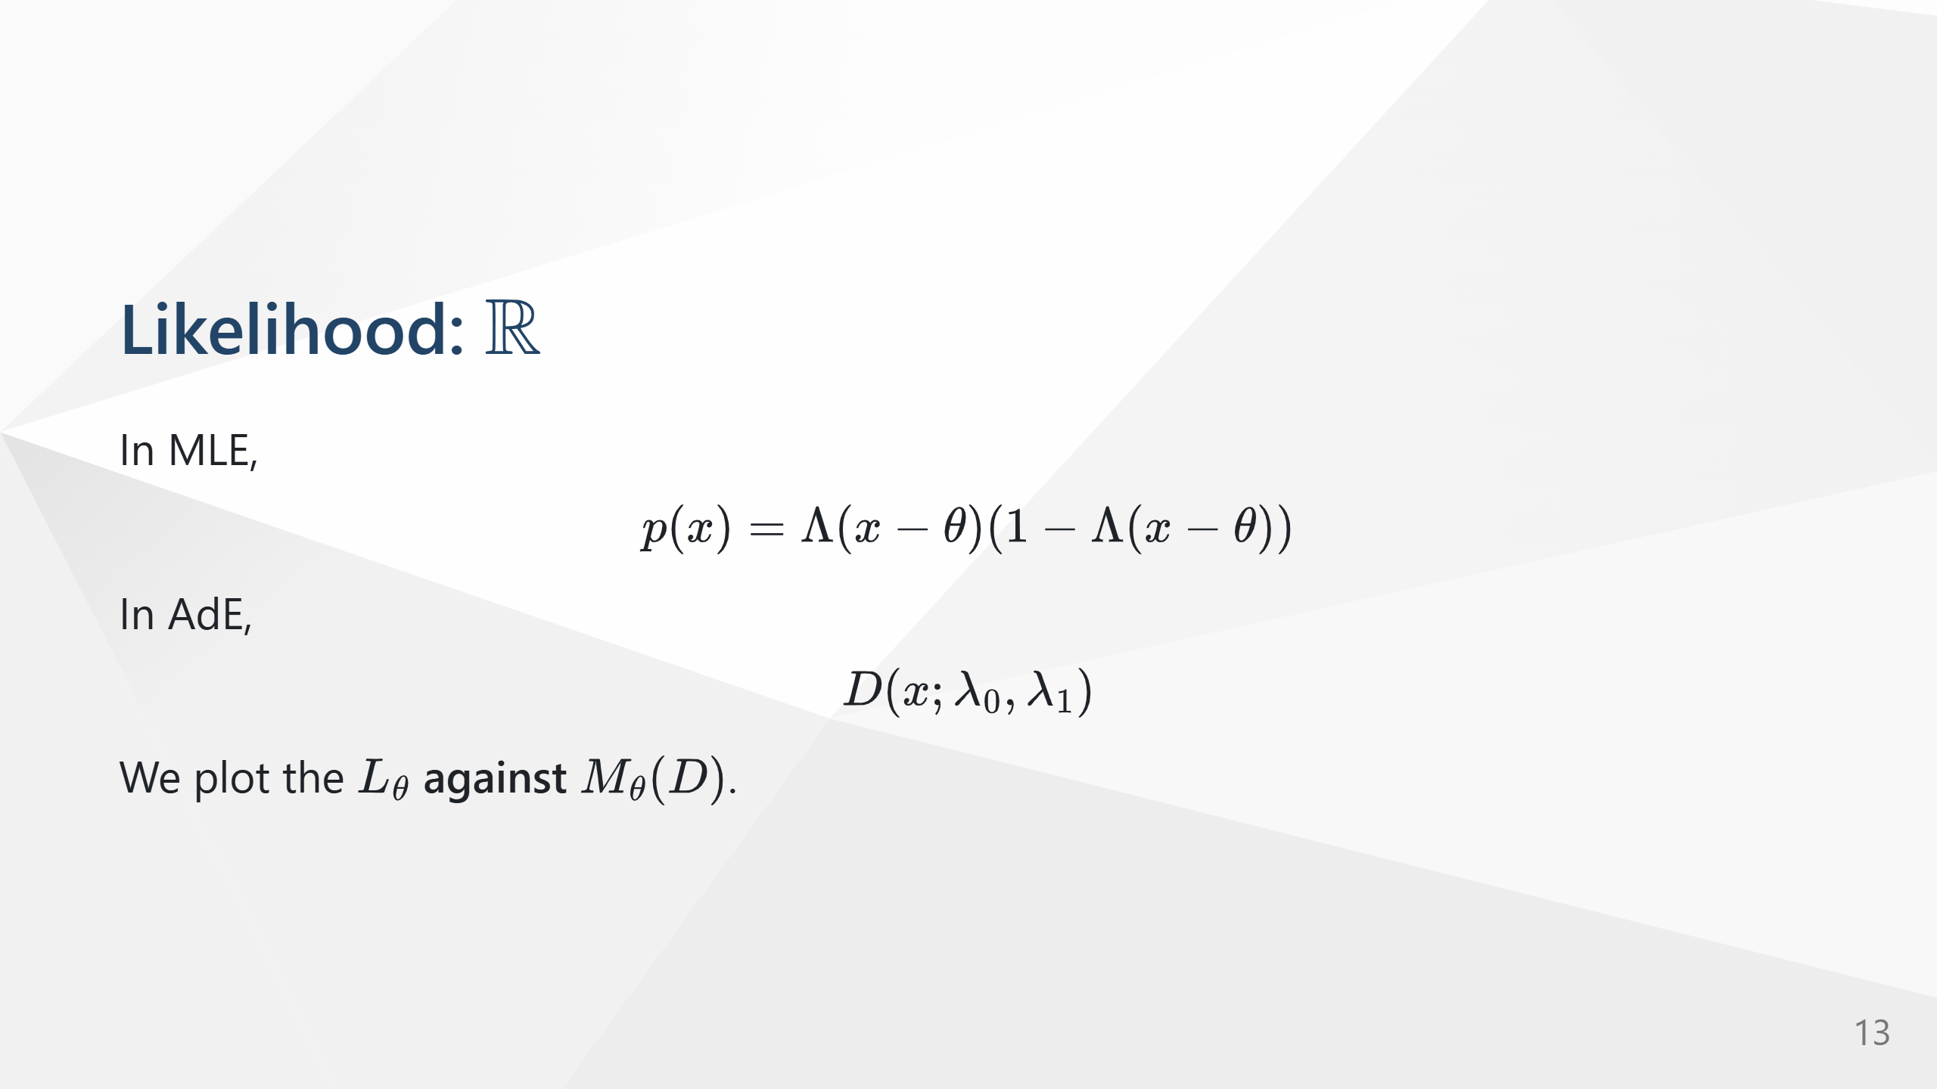
Notes:
We assume that $$p_r(x) = \Lambda(x) (1-\Lambda(x))$$

Slide 14
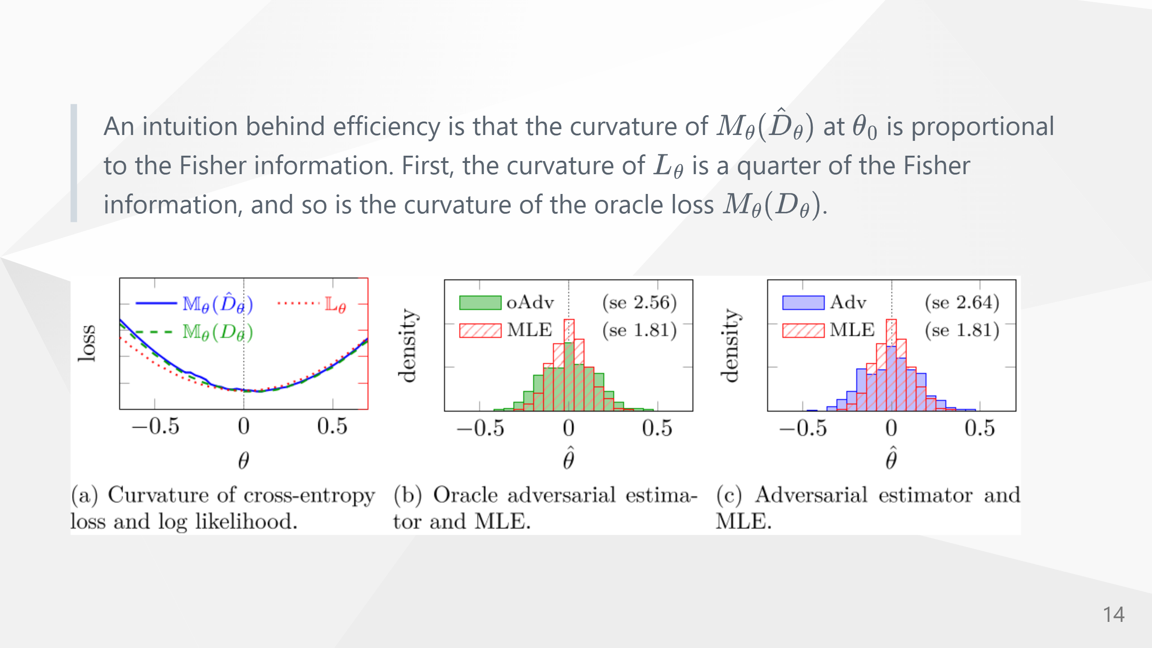

Slide 15
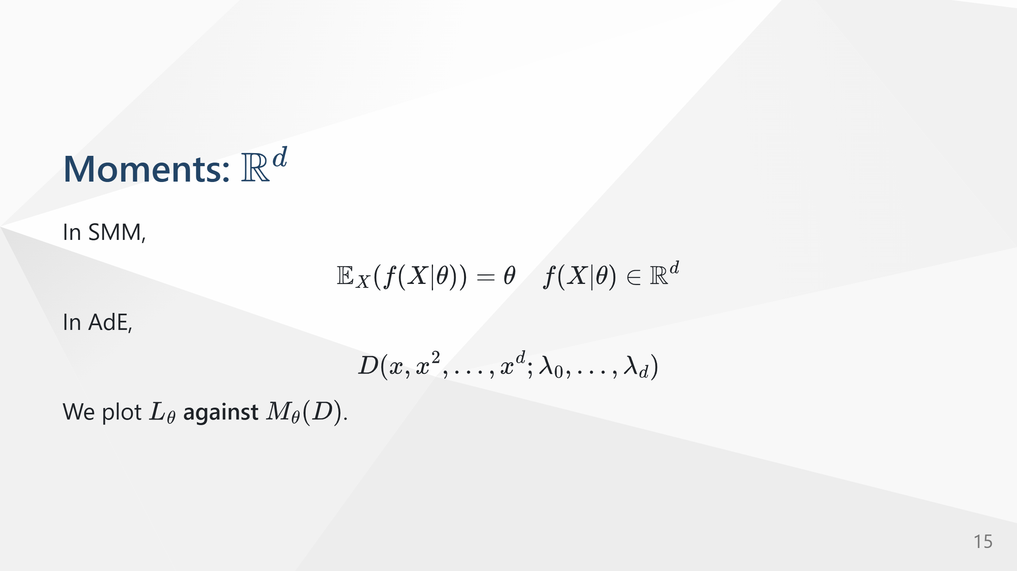

Slide 16
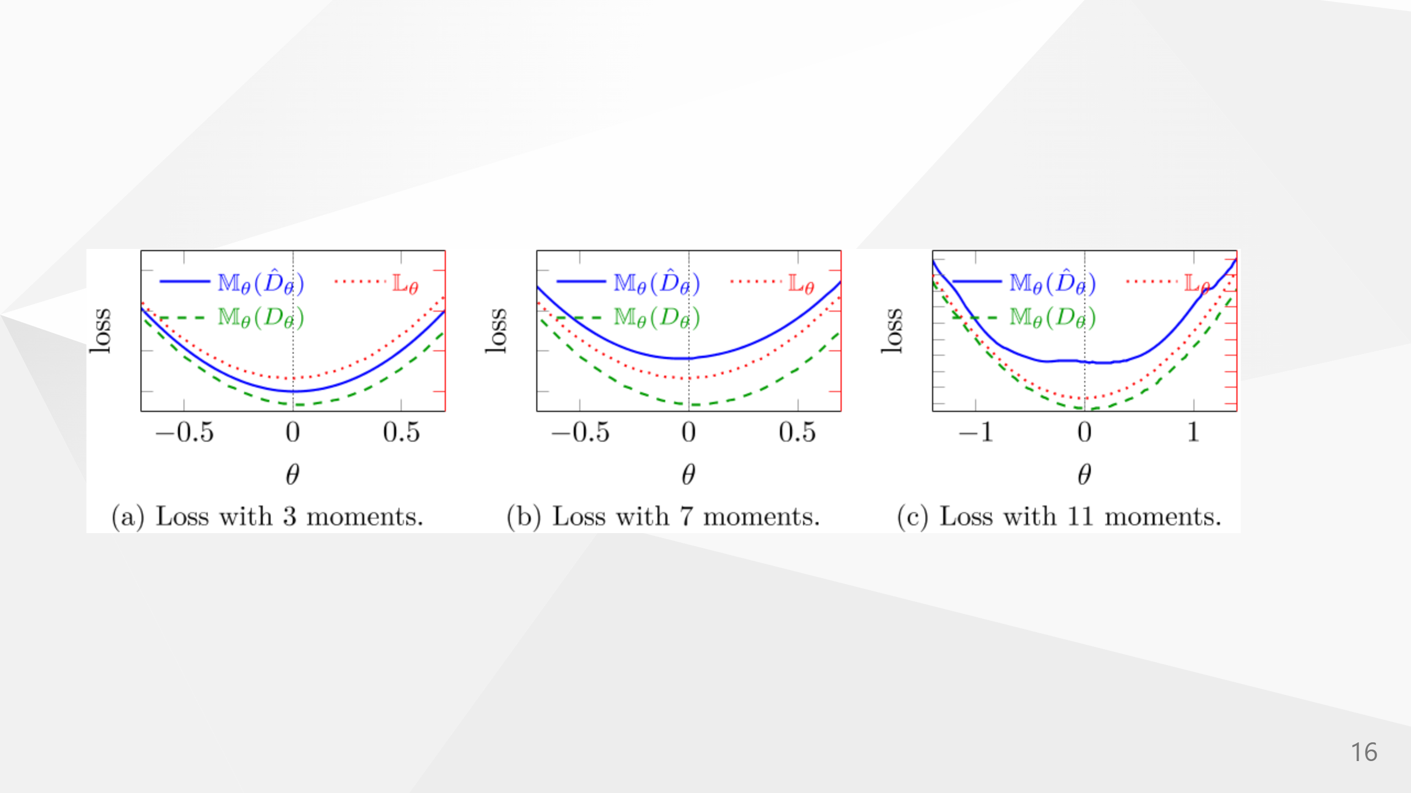

Slide 17
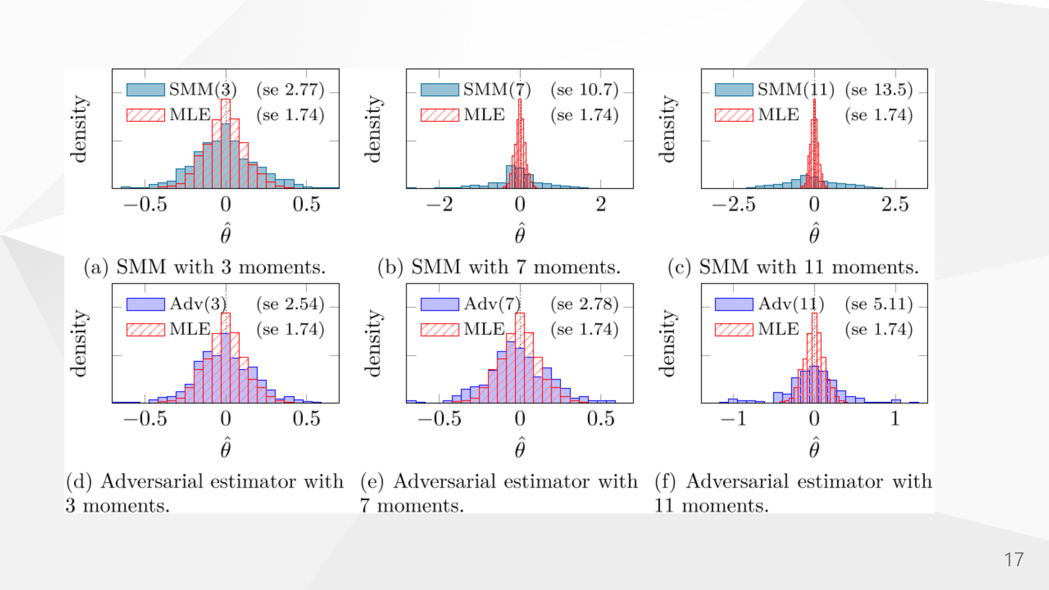

Slide 18


Slide 19
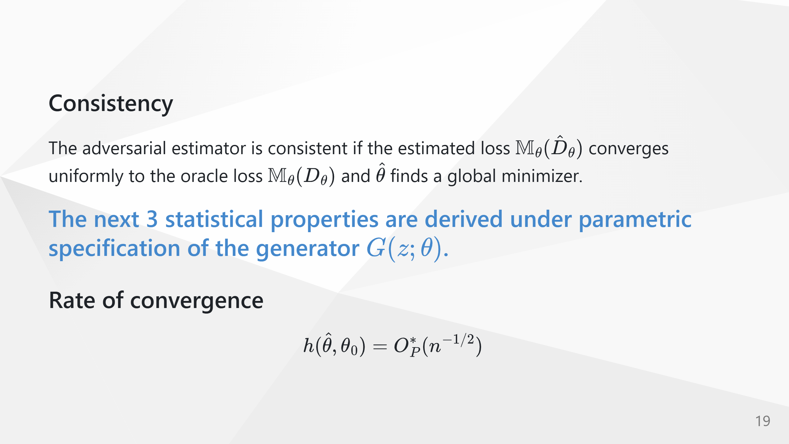

Slide 20
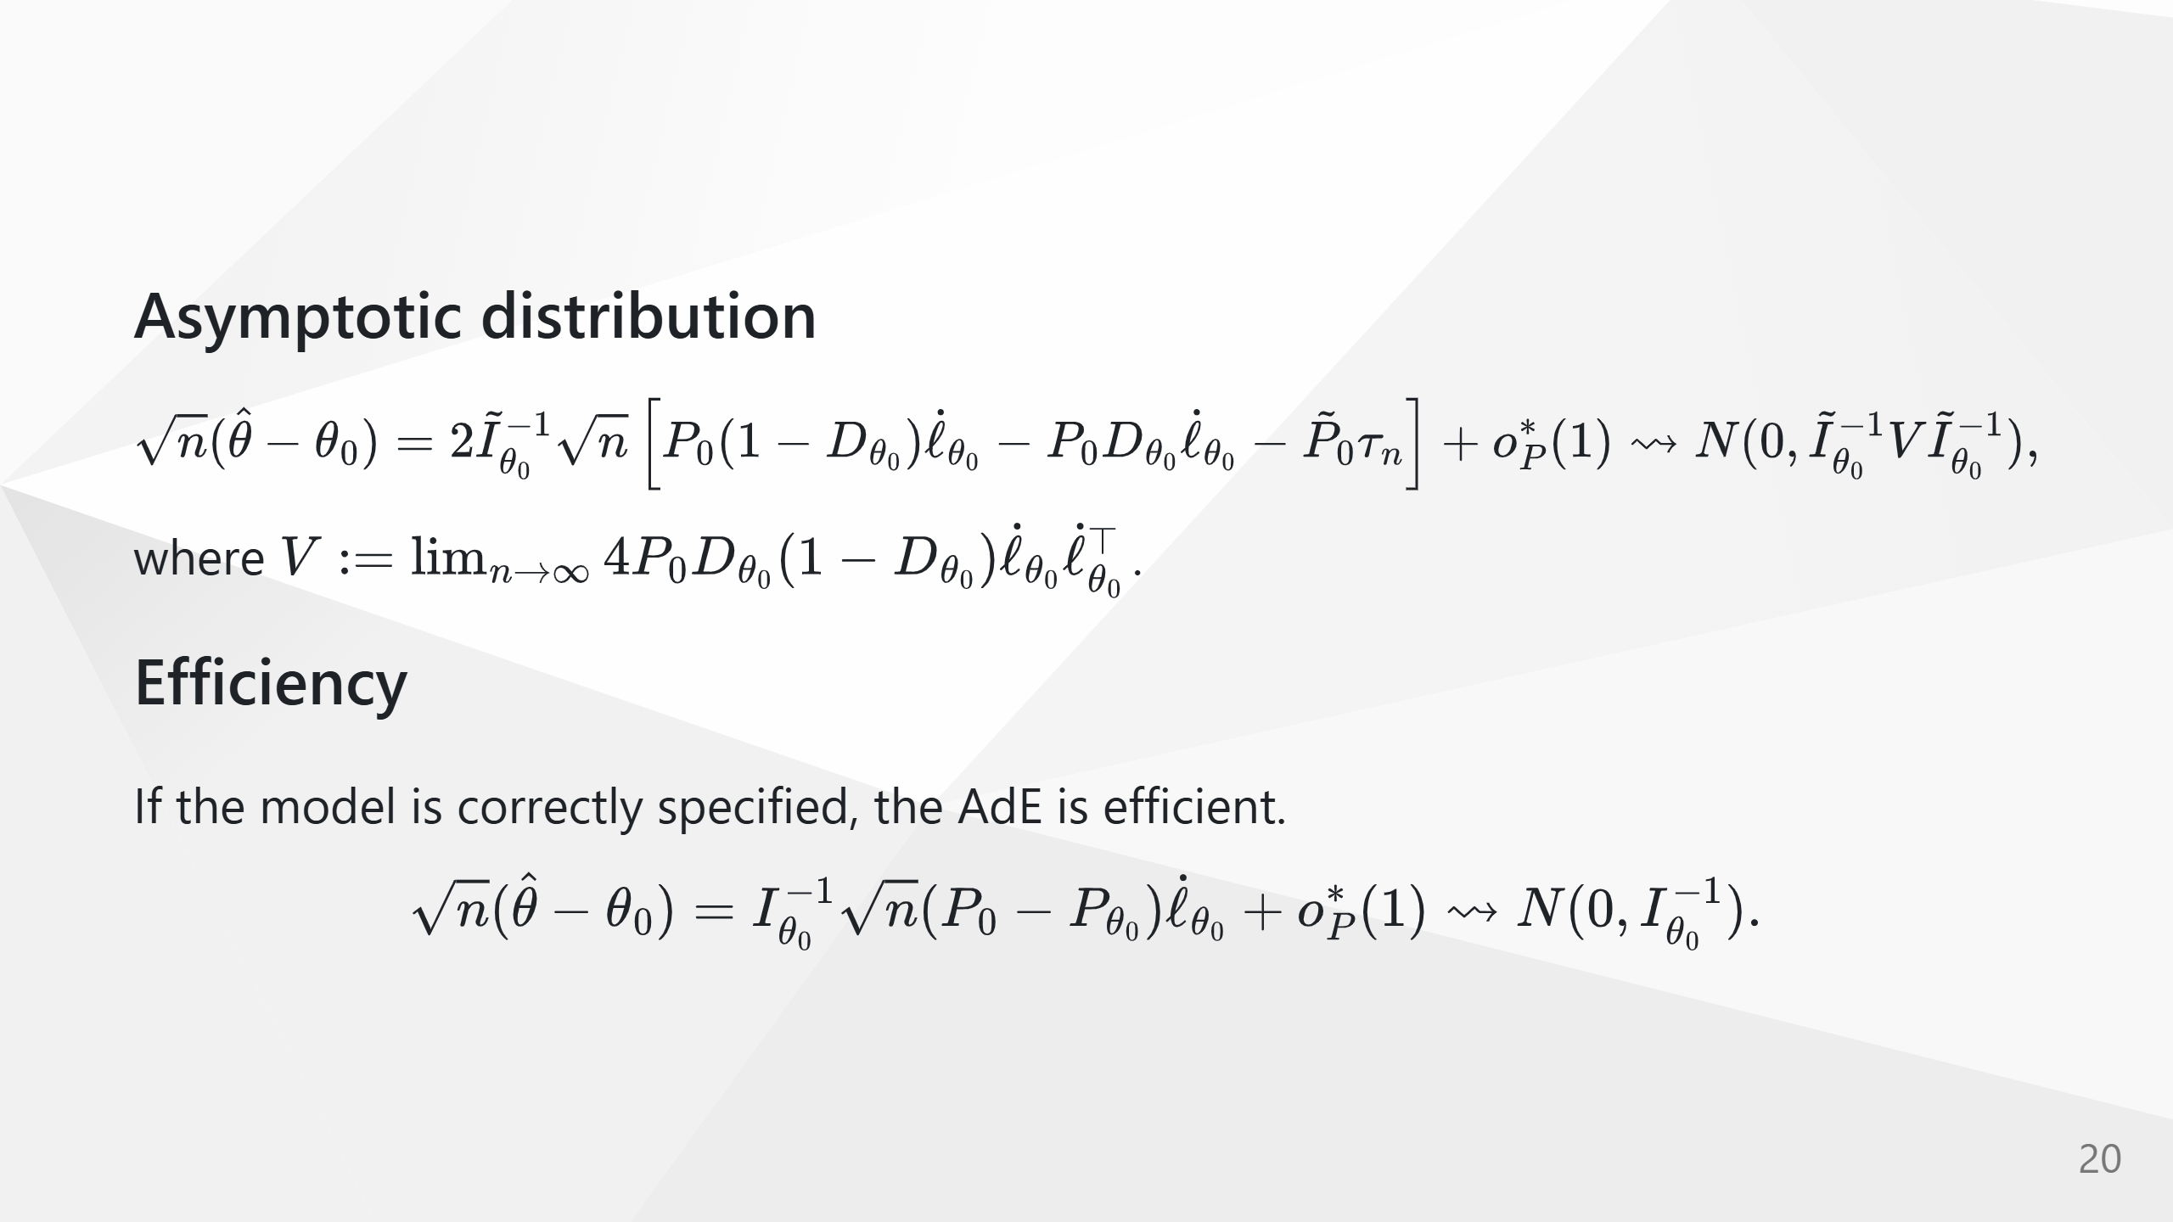

Slide 21
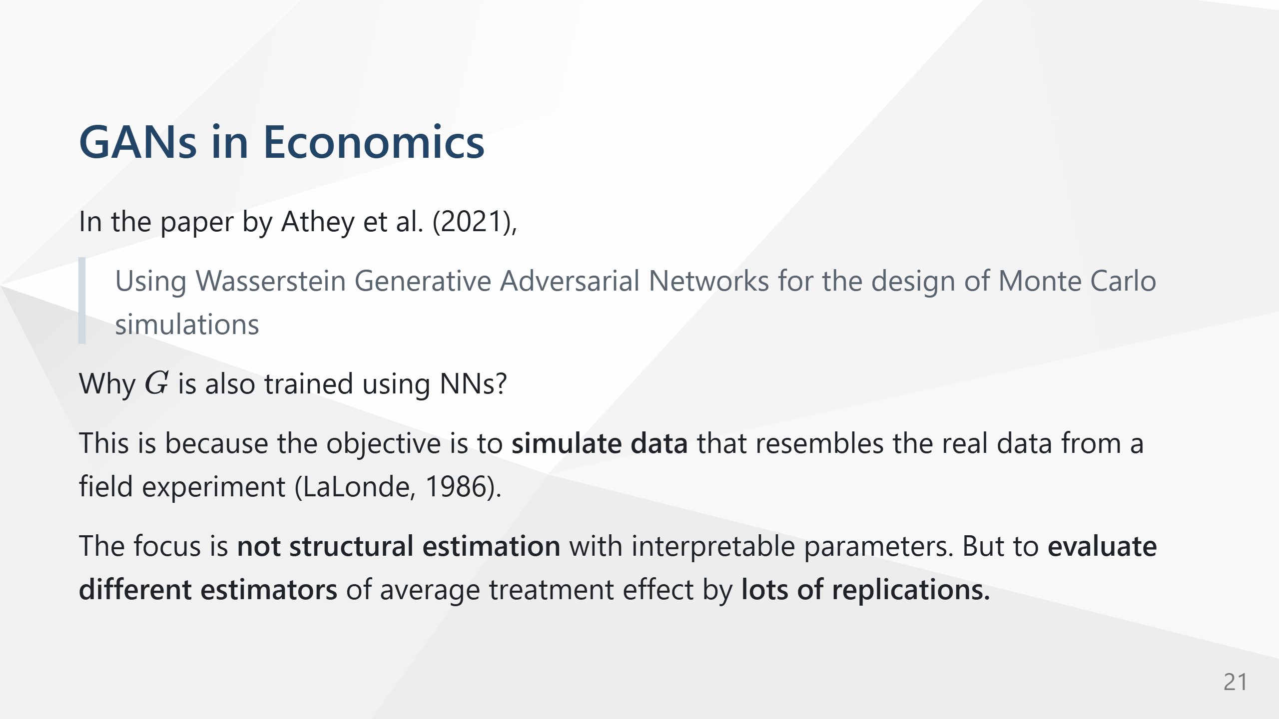

Slide 22
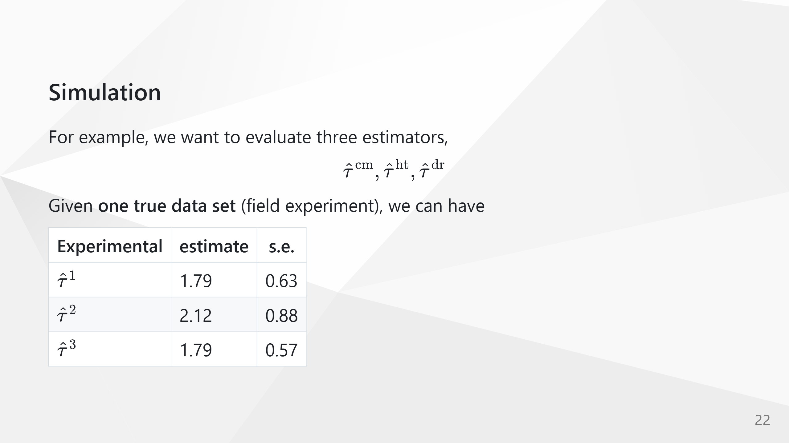

Slide 23
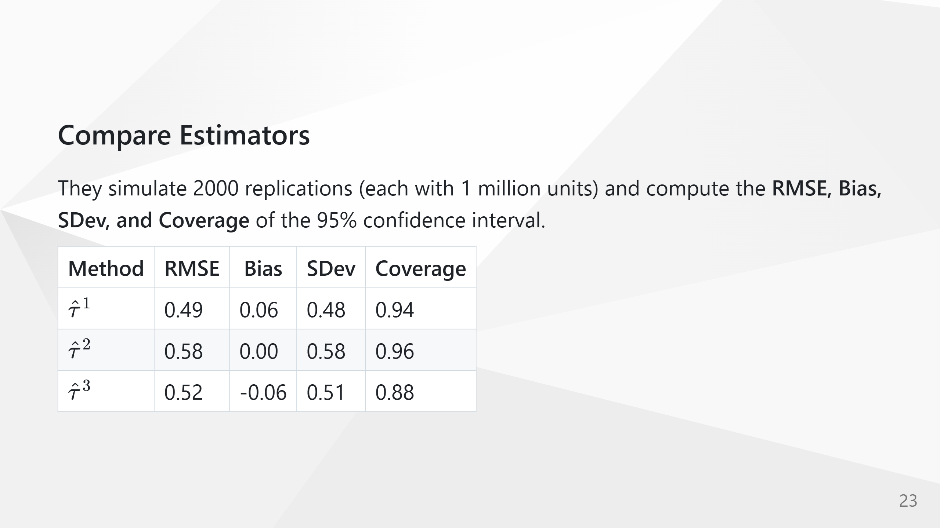

Slide 24
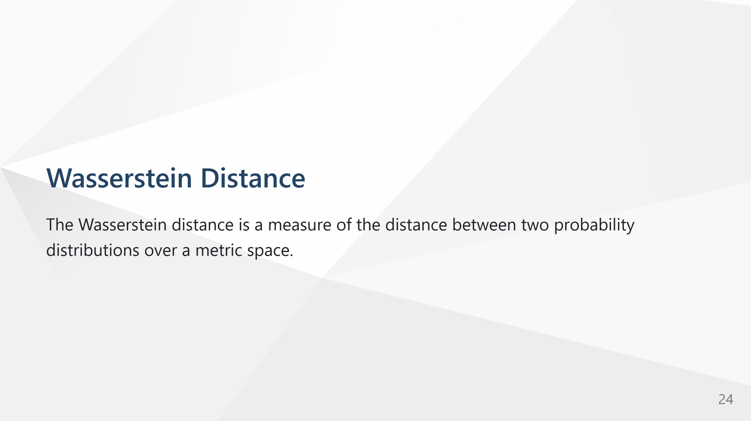

Slide 25
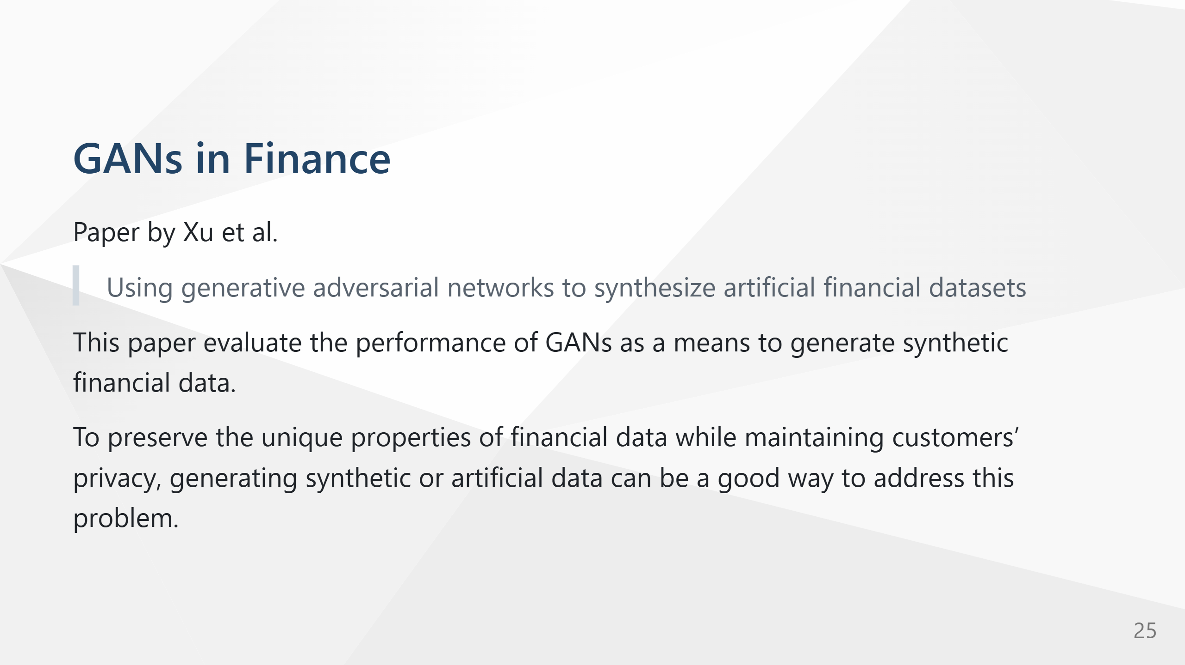

Slide 26
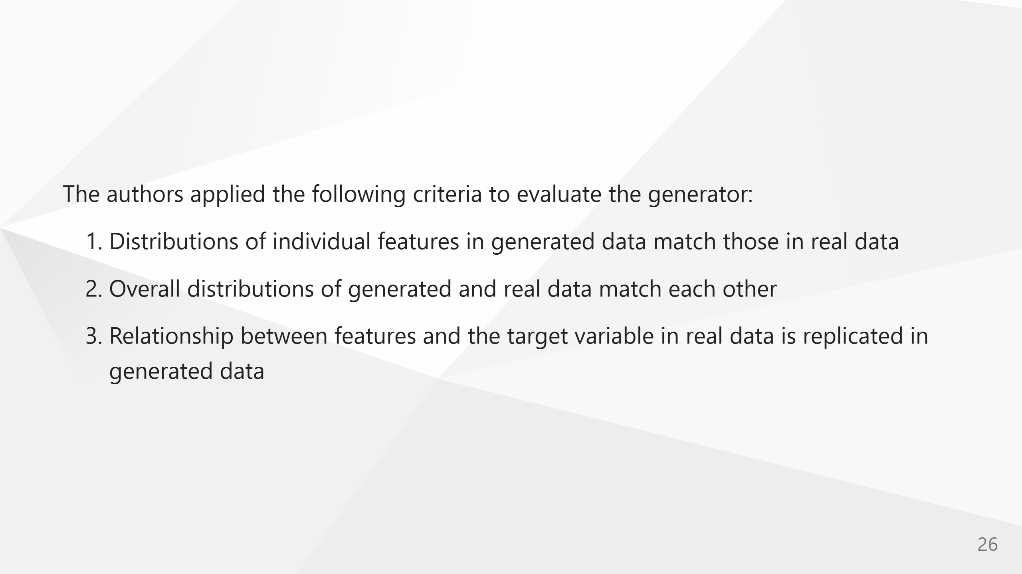

Slide 27
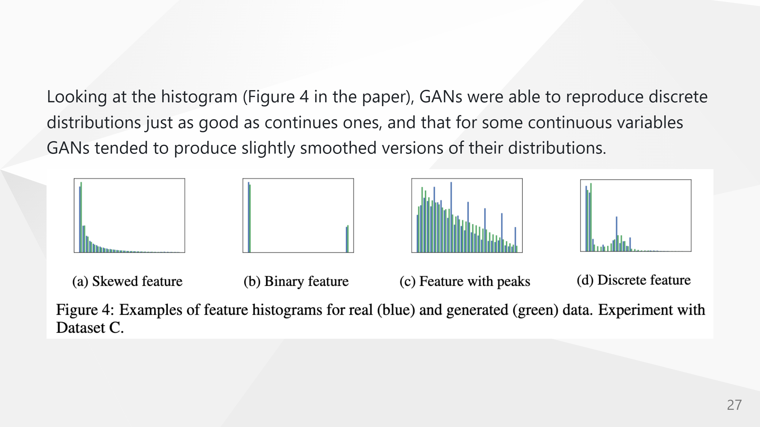

Slide 28
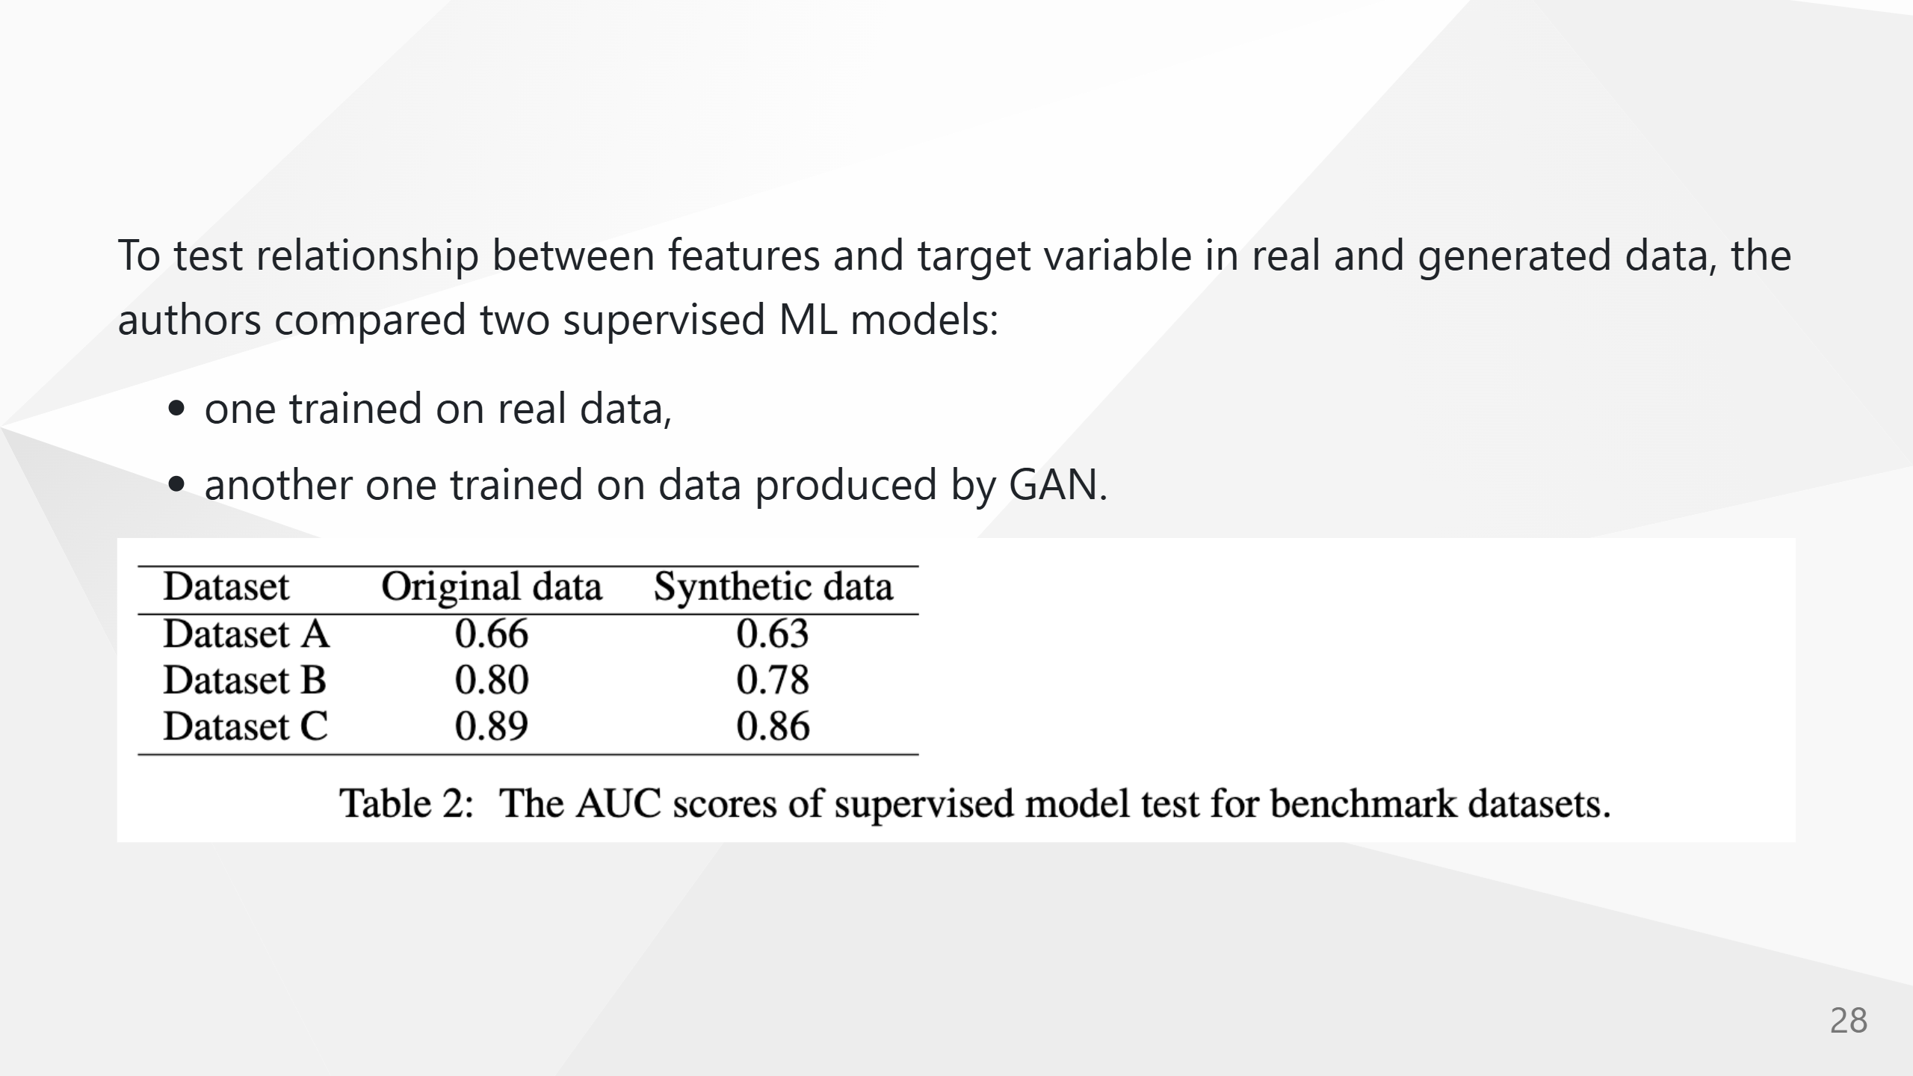
Notes:
AUC scores (in Table 2) were calculated for ground truth target values and predictions obtained from the models trained on real and generated datasets. These scores to be close enough to assume that our GAN model replicated the relationship between the target variables and the features with good accuracy. Overall, the authors conclude that GANs can learn and accurately reproduce intricate features distribution and relationships between features of real modeling data.

Slide 29
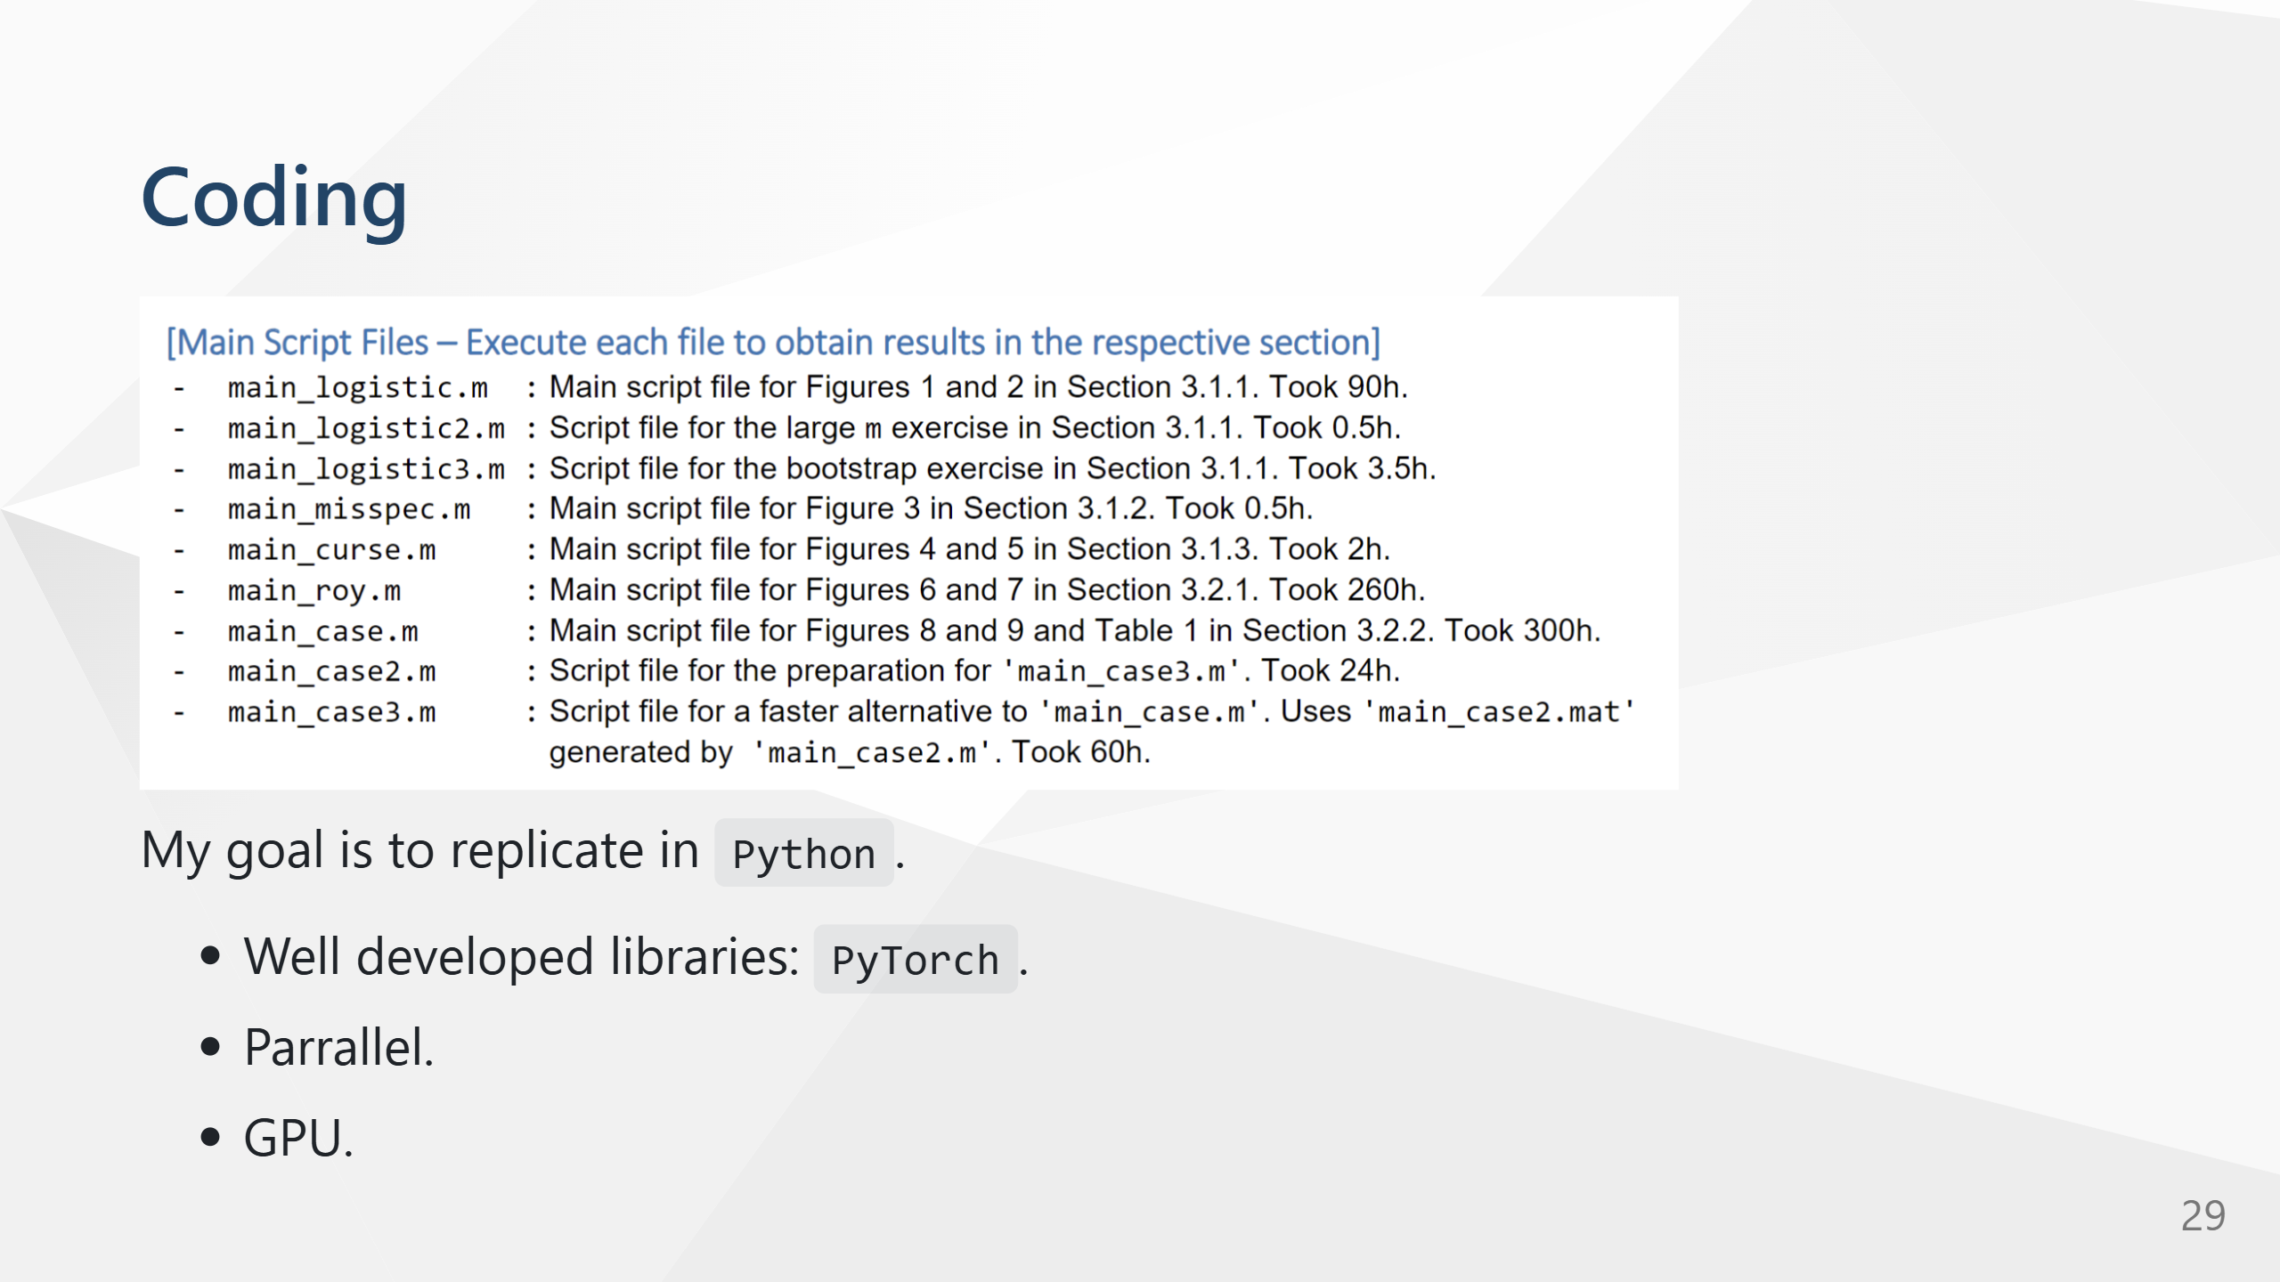

Slide 30


Slide 31
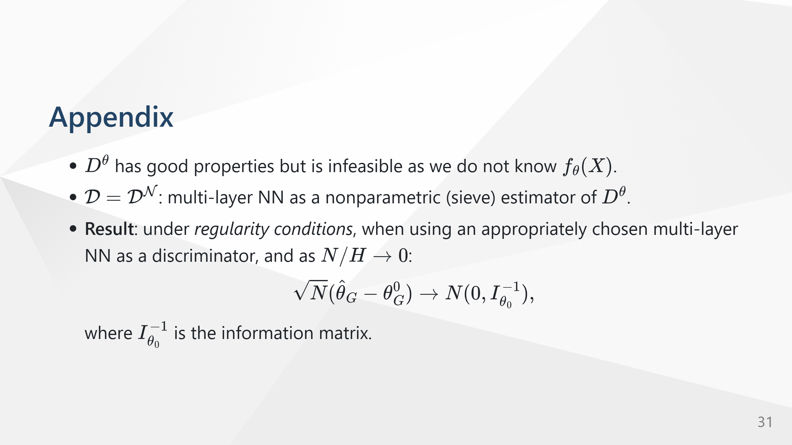

Slide 32
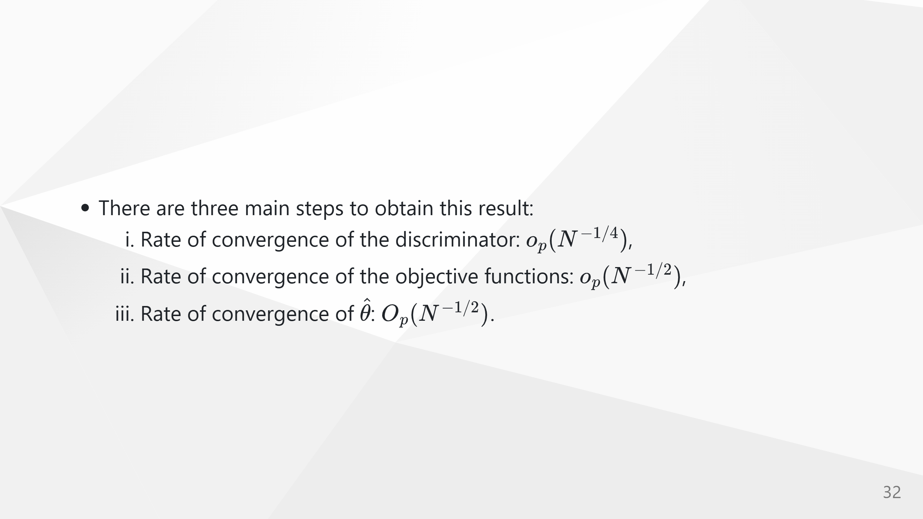
Notes:
![bg 60% ](https://miro.medium.com/v2/resize:fit:1400/1*jDPj5v3JKGRRRyDZmQTkpQ.gif) ![bg 50% ](https://lilianweng.github.io/posts/2017-08-20-gan/GAN.png)

